Slide 1
Daily Bible
Gloria Kim
Notes:
Good afternoon,
My name is Gloria Kim, and I am going to introduce an android app that I named “Daily Bible.”

Slide 2
01
WHY I MADE THE APP
Notes:
So why I decide to make this specific Bible app?

Slide 3
—Psalm 1:1-2
“Blessed is the one whose delight is
in the law of the Lord and…meditates on his law day and night.”
Notes:
Well, Psalm[salm/썸] said that, Blessed is the one whose delight is in the law of the Lord, and meditates on his law day and night. As a Christian, I believed in these words, and I wanted to meditates the Bible day and night!

Slide 4
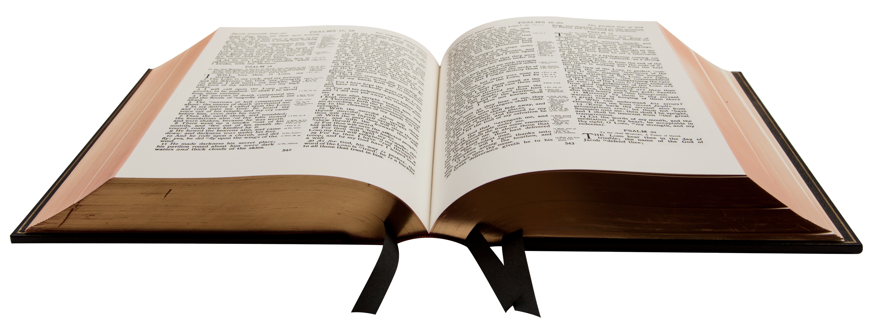
1,200 PAGES?!
However, reading the Bible may be overwhelming…
In fact, the Bible has over 1,200 pages to read!
Notes:
But the Bible is maybe the thickest book in the world, having 1,200 (one thousand two hundred) pages… Well, it’s pretty overwhelming, isn’t it?

Slide 5
HOW OFTEN CHRISTIANS READ THE BIBLE?
32%
Everyday
68%
Not Everyday (12% Rarely/Never)
Notes:
In fact, I’m not the one who felt overwhelmed. A lot of Christians feels the same, and they don’t read the Bible as much as they should. So I decided to make an app that can sends a daily notification to read the Bible little by little!
Reference: https://factsandtrends.net/2019/07/02/how-many-protestant-churchgoers-actually-read-the-bible-regularly/

Slide 6
02
WHAT I ADDED IN THE APP
Notes:
So what’s exactly in my app?

Slide 7
ACHIEVETHE BIG GOAL!
Many business magazines recommend to…
Set a realistic goal
Set a measurable goal
Create an action plan
Give a reward to yourself
Notes:
First, I wanted to include some features to help reaching the BIG goal, reading over 1,200 (one thousand two hundred) pages! I found that many business magazines recommend to set a realistic goal, a measurable goal, an action plan, and rewards when the goal is reached.
Reference: https://www.inc.com/marcel-schwantes/want-to-reach-your-big-goals-make-sure-to-do-these-8-things.html

Slide 8
REALISTIC GOALS
MESURABLE GOALS
REWARDS
ACTION PLANS
THREE READING PLANS
COUNTING DAYS
REWARD PAGE
DAILY NOTIFICATION
Notes:
Following the advices, I tried to include all these features. Specifically, to set a realistic goal, I know everyone has different reading preferences, so I offered three different reading plans from 90-day challenge to a regular one-year plan. Also, to make the goal measurable, I counted the number of days the users start reading the Bible. This way, users know how many days they are left to complete the Bible. To set an action plan, I send the users daily notification. And to reward users, I created a reward page that basically shows a simple statistics, so users can get motivated to read more!

Slide 9
03
HOW I MADE THE APP
You could enter a subtitle here if you need it
Notes:
Now, I am going to explain how exactly I made the app, including all these features I mentioned.

Slide 10

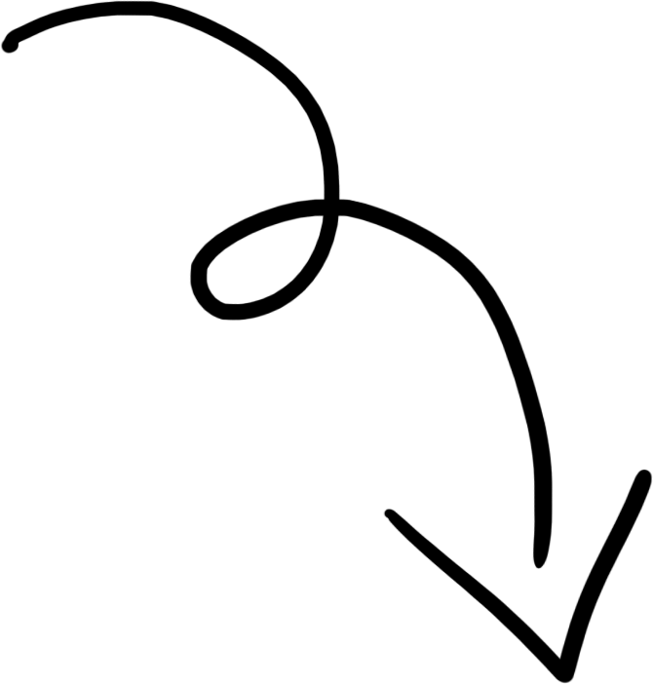
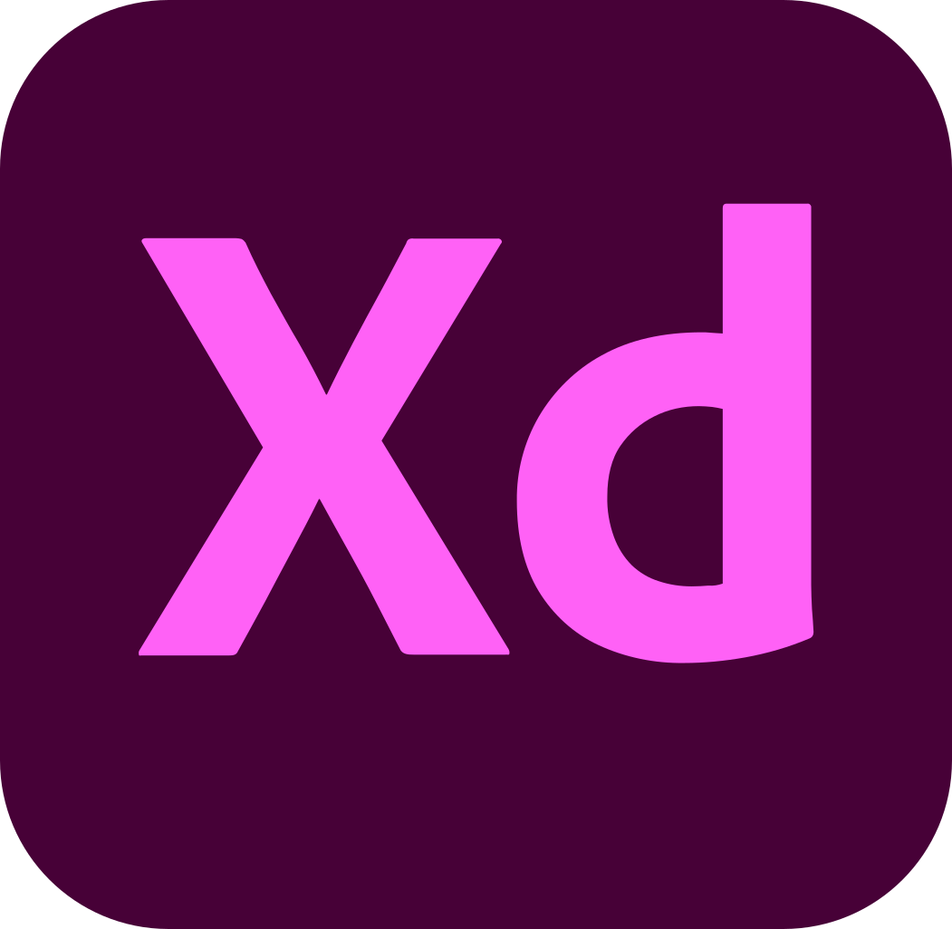
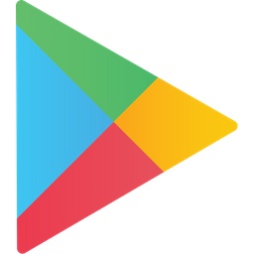

01
02
03
DESIGN Adobe XD
PUBLICATION Google AppStore
FUNCTION Android Studio
Notes:
Before I build any actual functions, I like to design my app’s prototype first using Adobe XD, where I can quickly change design and basic functions. It took me less than a day (probably about 3-4 hours), so I was able to quickly move to build the actual functions.
So, the actual functions were built using Android Studio. I kind of knew how to use it, so I was able to write XML codes to build the design aspects pretty quickly. However, I was not familiar with the rest of stuffs. For instance, I have no idea how to build external database using Firebase. I spent a lot of time watching YouTube to understand the concept, follow the codes and found that somehow the codes are not working in my app, and I tried to fix the issue, and if nothing works, I went back to YouTube to find something else and so on.
Now, I am in the process of publishing the app on Google AppStore. I finished creating the advertisement parts, but the APK is finicky to me and am resolving that issue.

Slide 11



LIVE DEMO
Notes:
Live demo! I will run Android Studio to demonstrate my app now.
As you can see, before I set an alarm, the main page will say to set an alarm to start reading. So I will move to the alarm section to set an alarm. I will set a 90-day challenge, and set the alarm time for now to receive the notification as soon as possible. The notification will arrive within a minute, so please be patient with me.
So here comes the notification! When I click this notification, it automatically opens the app, showing the reading plan.

Slide 12
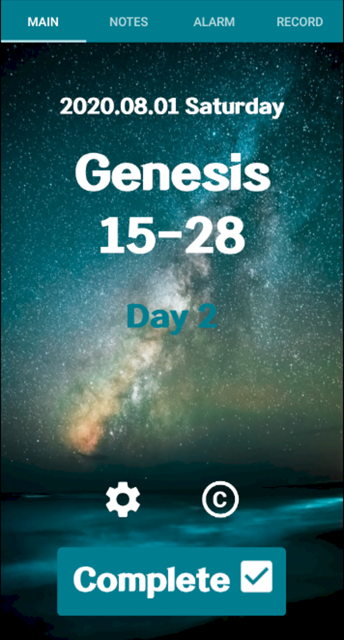
MAIN PAGE
Functions:
MESURABLE GOAL!
Today’s Date Today’s Bible Verse Number of Reading Days Complete Button Setting Credit
Notes:
So in the main page, I listed out today’s date, today’s bible verse, and number of reading days based on the reading plan the user set. Users can click the complete button once they finish. When the user reopens the app, the content will say to come back tomorrow to see tomorrow’s reading plan. So I change my date to tomorrow, and ta-da, the users can now see day 2’s reading plan.
I also created the setting and credit pages. On the credit page, I listed out creditors for app icons and photo with hyperlinks. When I click the hyperlinks, it will direct me to each creditor’s webpage.

Slide 13
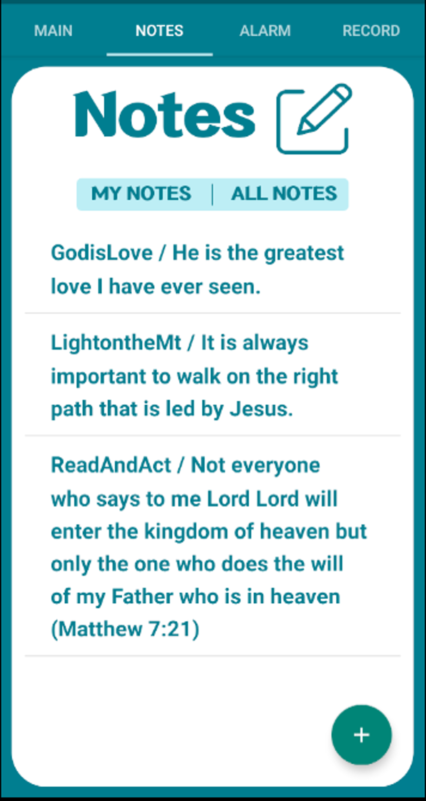
NOTE PAGE
Functions:
Private Note (Create, Edit, Delete) Public Note (Create) Floating Button
Notes:
Notes can be created by clicking the floating button on the right-bottom corner. When you click the button, you will see two sections to fill out: userID and notes. UserID is not necessary to fill if you meant to create private notes, which are stored in phone’s internal database. Let me create the private notes to show you. I will fill out both sections to show that user ID will not be stored in private notes.
As you can see, the private notes simply show the notes, not user ID. The created private notes can be edited or deleted as well. Let me edit the note by clicking it. I am going to add some notes and hit edit. Now, the updated note is shown. To delete the note, simply click the note again and hit the delete button. Then the note is now deleted.
Move to the public note areas, you can see all saved notes by clicking “ALL NOTES”. To create a public note, click the floating button again. Now, you need to insert user ID, and otherwise, the app will toast you error message. So let me fill out both userID and notes., and hit save to store in Firebase. Now, if you click ALL NOTES again, you will see the public note that you just saved.

Slide 14
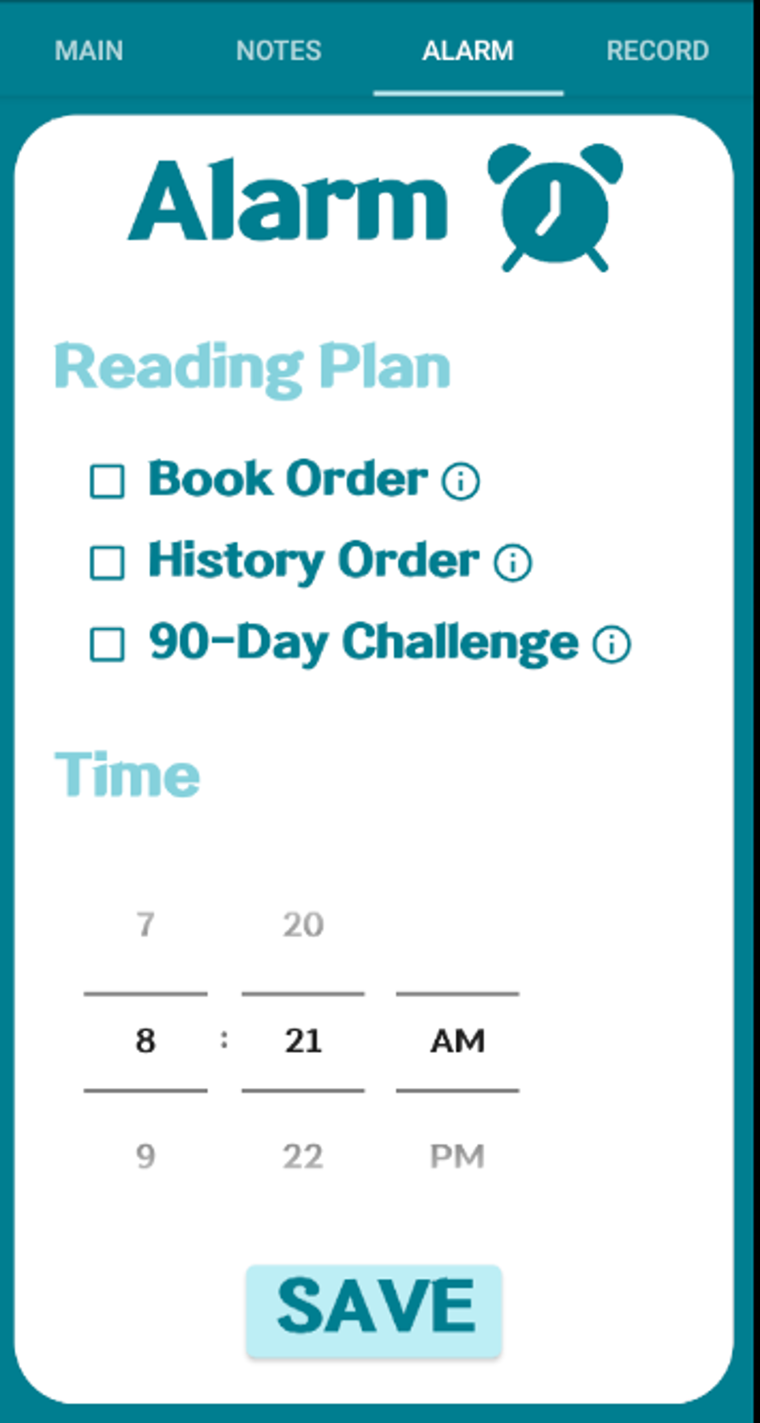
ALARM PAGE
Functions:
ACTION PLAN!
Reading Plan (90-Day, Bible Order, History Order) Reading Plan Info Alarm Time
REALISTIC GOAL!
Notes:
So here comes the most important feature—setting the alarm! I said an “alarm” but precisely it is more like a notification. So users can set any of the reading plans listed out here, and they can also see more detailed information by clicking “I”. Users can also set the specific time to send their notification as well.

Slide 15
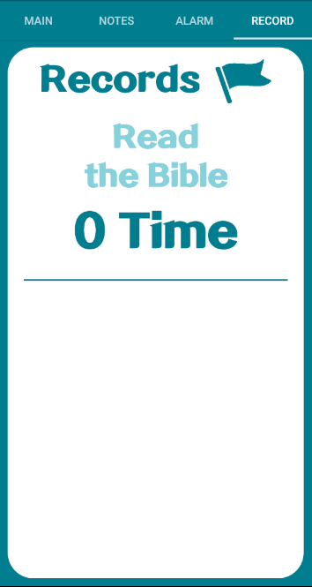
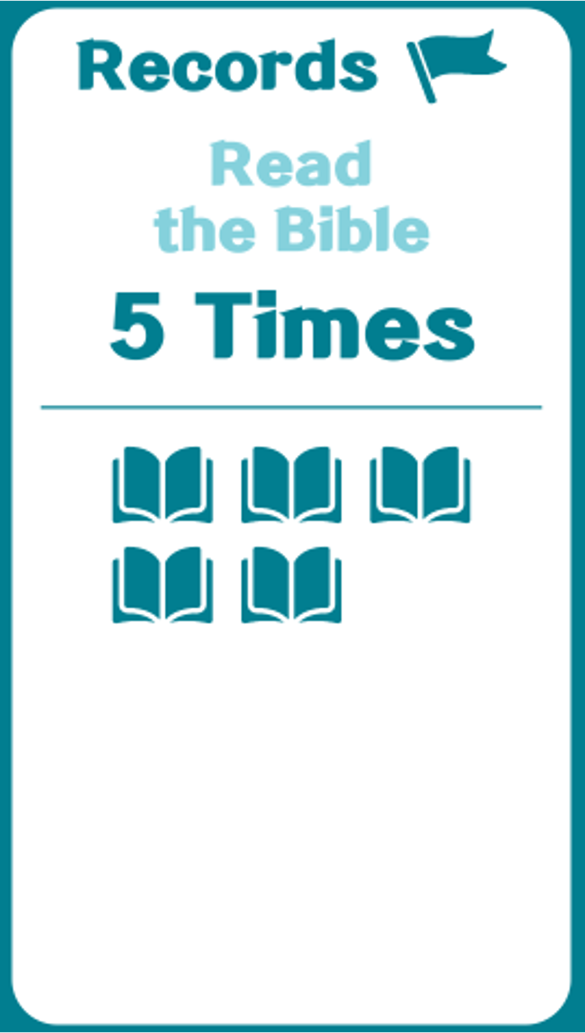
REWARD PAGE
Functions:
REWARD!
Number of Completion Bible Icons
Notes:
Now, the reward part comes. The app counts the number of times the users completed reading the entire bible, and lists out the information as shown in the screen.

Slide 16
“Not everyone who says to me, ‘Lord, Lord,’ will enter the kingdom of heaven, but only the one who does the will of my Father who is in heaven.”
—Matthew 7:21
Notes:
As for future work, I have two things in my mind. I heard that Flutter allows to create both Android and iOS apps, so I plan to use it to build the app for both Android and iOS. And another thing is this quote. In Matthew 7:21, the Bible says “Not everyone who says to me, ‘Lord, Lord,’ will enter the kingdom of heaven, but only the one who does the will of my Father who is in heaven.” So I plan to include features to show action plans to take actions in life to live like the Bible.

Slide 17
THANKS!
Any Questions? ☺
Notes:
So that’s it! Thank you for your attention, and I would be happy to answer any questions you have.

